Slide 1


Slide 2
Online Bill Correction Web Application

Slide 3
Development Team:
Muhammad Akram, Manager(New Billing Development)
Afshan Bilal, Dy. Manager
Muhammad Nadeem Siddiqi, Dy. Manager
Amna Ejaz, Assistant Manager
Nasir Mahmood, Software Developer

Slide 4
Bill Adjustment Types Covered in 1st Phase:
Wrong Reading Correction up to 300 units for domestic & Commercial Consumers
Extension of Due Date
Installments of Bill

Slide 5
Offices Where Software will run in 1st Phase:
Customer Care Center
SDO Offices
Revenue Offices

Slide 6
Modes of Operation
One Window at Customer care Centers
Normally consumer get approval of competent authority on his application or even on electricity bill.
On window, adjusted bill will be issued and there is no need to visit Revenue office for getting amended bill
All type of consumers will be served for extension of due date & Installments
Correction of reading is allowed up to 300 units to domestic and commercial consumers only.
CP-052 will be posted on IBS Live database and duplicate bill database will be updated automatically on issuance of amended bill and CP-052 can also be printed.
Consumer can pay amended bill only on bank counter
Supervisor can view the list of posted adjustments

Slide 7
Prerequisites for running the application:
PC
Internet Connection
Laser Printer
Any browser application running on PC

Slide 8
Modes of Operation
Control Panel
Administrator
Will add users
Will assign roles
Only relevant role to a user. So that users can access relevant tasks only
Multiple roles can be assigned to a user

Slide 9
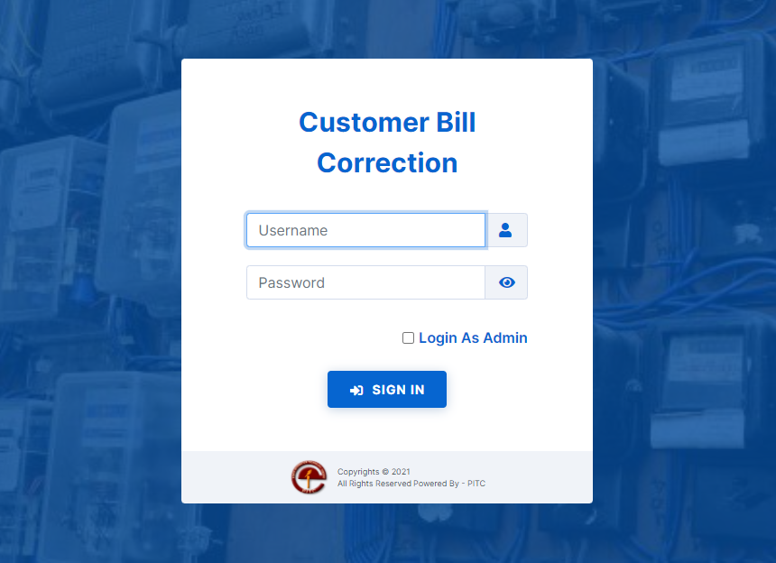
Application Link
http://billadj.pitc.com.pk/mepco

